Slide 1
Judge Jodhi
Discussion and Activity Slide Template

Slide 2
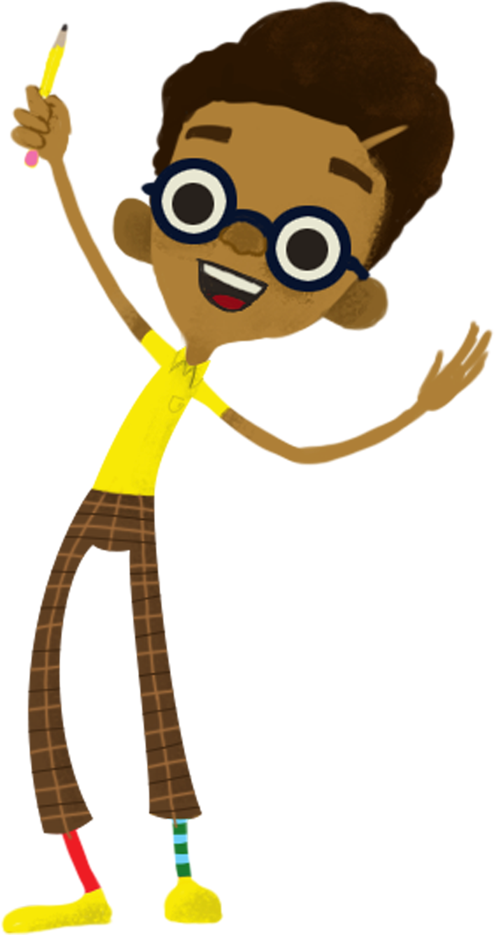
For Teacher Reference

Slide 3
Teacher Guidance
This Lesson Builder helps you create a lesson that invites students to reflect, consider multiple perspectives, and practice the ideas together.
How to Use This Lesson Builder
Select your Judge Jodhi episode from the Master Episode Deck.
Copy the Title Slide for your episode.
Review the Story Summary & Learning Objectives.
Use the following slides to build a lesson that helps learners engage with the episode and practice the related SEL and Citizenship skills.

Slide 4
Using the Template Discussion and Activity Guide
You will create:
A preview discussion (to activate prior knowledge, surface learners’ experiences, and prepare them to engage with the episode)
A post-viewing discussion (to deepen shared understanding of the skills in the episode, check for comprehension, and help learners apply the ideas to real situations)
A hands-on activity (to embody the learning through action and transfer the episode’s themes into learners’ daily lives and relationships)
A reflection & home connection (to reinforce the learning, support personal meaning-making, and extend the skills into the home environment)

Slide 5
Class-Ready Slides

Slide 6

Lesson Title Here
Notes:
Beginning of student slides

Slide 7
Before we watch
Example question: Why is this skill important?
Notes:
Discussion Notes: Help students understand and define the SEL or Citizenship skills presented in the episode. The goal is to surface previous knowledge and create a common understanding.

Slide 8
Before we watch
When have you ever used this skill? How did it feel?
Notes:
Discussion Notes: Encourage children to share their previous experiences using this skill to help them personalize the lesson.

Slide 9
Before we watch
Today’s episode is about ____________and
what happens when _________________________
As you watch, consider the characters choices/feelings/challenges.
Notes:
Discussion Notes: Prepare learners to follow the episode story and form opinions that they can share in the post viewing discussion.

Slide 10
Pause for discussion before the verdict
Discuss the case.
Examples: Who was the plaintiff? What did they complain about? Why did they feel that was wrong?

Slide 11
Consider the case
Discuss both parties’ feelings and motives.
Examples: How do you think [name] felt being
accused of [incident]? Why did the plaintiff feel
that [incident] was wrong?

Slide 12
Share your verdict
Discuss the potential verdict.
Examples: Whom do you think is right – [name], [name], or something in between? Why?
What do you think Judge Julia will decide?
Watch the rest of the video to find out.
Notes:
Discussion Notes: Solicit children’s opinions, but do not comment on whether you agree or disagree until after the end of the episode.
After the discussion, show children the rest of the episode, with Jodhi’s decision.

Slide 13
Post-viewing discussion
In the end, what did Jodhi decide? Why?
Notes:
Discussion Notes: Encourage children to think back to their verdicts. Did Jodhi reach the same conclusion? Why or why not?

Slide 14
Post-viewing discussion
Additional discussion points…
such as pro’s and con’s of the verdict.
Notes:
Discussion Notes: You may continue the discussion if the class has differing opinions on the verdict. This is also an opportunity to consider how the home story line connects to the courtroom issue.

Slide 15
Take it further: In-Class Courtroom
We need two volunteers to pretend to be the kids in a new case.
One will pretend to be the plaintiff, and the other will be the defendant.
Each will act out his/her side of the case.
Today’s case is:
Notes:
Discussion Notes: Turn the issue explored in Judge Jodhi’s case into a dilemma that kids in your school might face, such as two kids in a class project who each have their own opinion about who is doing the most work.

Slide 16
Take it further: In-Class Courtroom
Kid #1: Provide talking points for the plaintiff
Kid #2: Provide talking points for the defendant
Notes:
Discussion Notes: Get the volunteer plaintiff and defendant prepared for their role with a few talking points that summarize their main arguments. Encourage the two volunteers to come up with their own points to support their positions too.

Slide 17
Take it further: In-Class Courtroom
Whom do they think is right: Kid #1, Kid #2,
or is it something in between? Why?
What would be the fair thing to do?
Notes:
Discussion Notes: Once the volunteers finish, it’s up to the entire class to form their own opinions about the case, and what they would decide if they were Judge Jodhi: Whom do they think is right: Kid #1, Kid #2, or is it something in between? Why?

Slide 18
Take it further: In-Class Courtroom
How is this case similar to the one in the episode?
How is it different?
Notes:
Discussion Notes: Encourage the children to make the connection between the SEL/Citizenship skills in the episode and this issue they may face in their classroom. You may explore other times when an issue like this tends to come up.

Slide 19
Take-home activity
Suggested Note to Send Home
Subject: Today’s Judge Jodhi Social and Emotional Learning
Message:
This week, students watched an episode of Judge Jodhi focused on [skill/theme].
Together, we talked about [big idea] and practiced this skill through [brief activity description].
At home, you might invite a short conversation by asking:
“What do you remember from the Judge Jodhi episode you watched today?”
“What choice did a character have to make?”
“What did you practice in class today?”
Thank you for partnering with us in supporting your child’s social
and emotional learning.

Slide 20
End of Lesson -

